Slide 1
Giving Rust a chance for in-kernel codecs
Daniel Almeida
Consultant Software Engineer
Collabora

Slide 2
Brief recap
Codec drivers ingest a lot of data from userspace
Previous intentions were to write a driver
A driver would need a layer of bindings

Slide 3
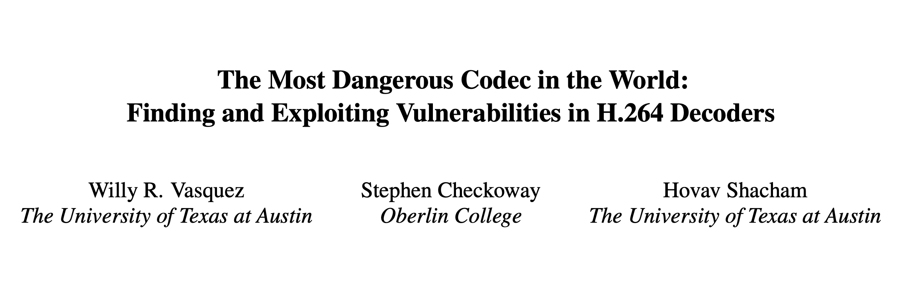

Slide 4
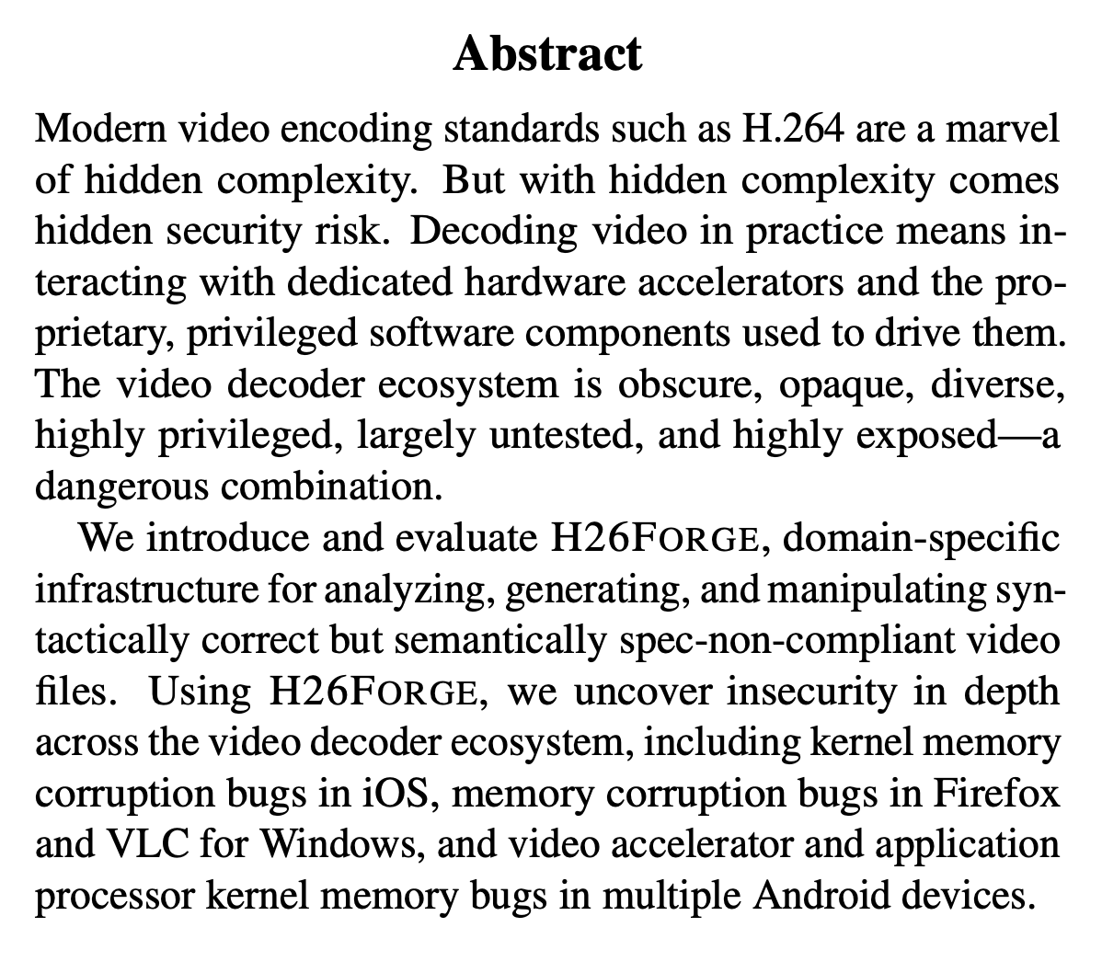

Slide 5
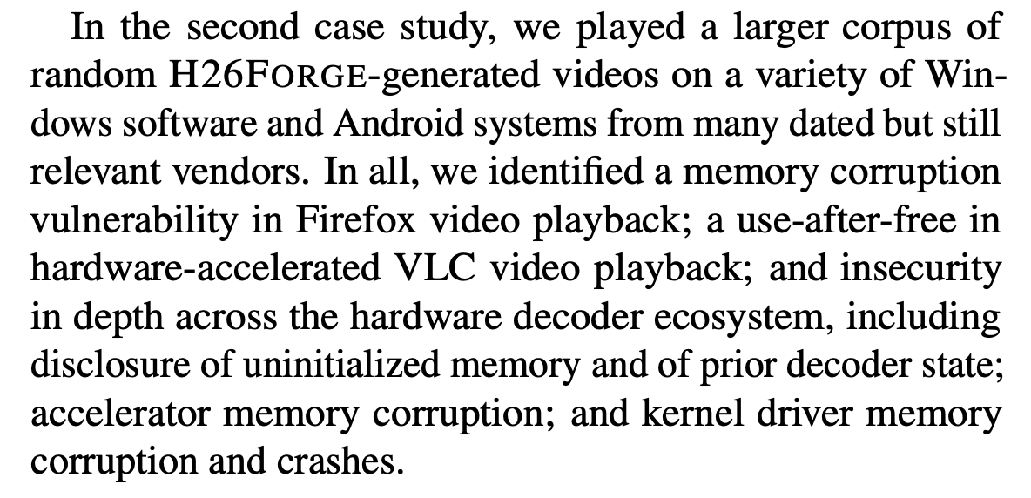

Slide 6
Feedback from last year
Who maintains what?
This will slow down development in C
This may break C code
The community is overwhelmed

Slide 7
What if we could write Rust code without bindings?

Slide 8
We can do so by converting a few functions at a time

Slide 9
This would sidestep most of the issues raised last year!

Slide 10
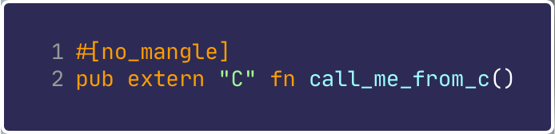
Generate machine code that can be called from C
Make it so the linker can find it
Can be used as an entry point to call other Rust code

Slide 11
We don’t want this: _RNvNtCs1234_7mycrate3foo3bar
  So no generics,
  No closures
  No namespacing
  No methods, etc.

Slide 12
We need this to be callable from C, hence “extern C”
Rustc will give us the machine code for the symbol.
That’s it really, the linker will happily comply.

Slide 13
The public API is then rewritten as per above
But we need a way to expose the new API to C somehow.
Because...

Slide 14
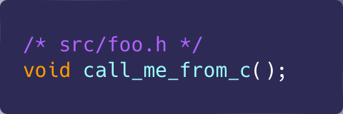
This works.
But it is not a good idea.
It can quickly get out of sync.
Nasty bugs can creep if we are not careful.

Slide 15
No worries, there’s a tool

Slide 16
Cbindgen
Cbindgen can automatically generate a C header
  Keeps things in sync
  Ensure proper type layout and ABI
Avoids link errors and/or subtle bugs
Maintained by Mozilla

Slide 17
Cbindgen
If a function takes arguments, cbindgen will generate equivalent C structs
This works because of #[repr(C)]

Slide 18
#include the header, that’s it.

Slide 19
Potential targets
This type of conversion works best when:
  There is a self-contained component
  That exposes a small public API
For video4linux, this means:
  Codec libraries
  Codec parsers

Slide 20
Codec libraries
Codec algorithms that run on the CPU
Results are fed back to the hardware
Abstracted so drivers can rely on a single implementation
Very self-contained

Slide 21
Rewriting the VP9 library
Two drivers were converted
There is a testing tool
We got the exact same score when running the tool
Relatively pain-free process

Slide 22
New proposals:

Slide 23
Proposals
Merge the code
Gate it behind a KCONFIG
Users get the C implementation by default
Run the Rust implementation on a CI
Eventually deprecate the C implementation

Slide 24
Thoughts?

Slide 25
Thank you!

